Slide 1

Social Science Research Design and Statistics, 2/e
Alfred P. Rovai, Jason D. Baker, and Michael K. Ponton
Pearson Chi-Square Contingency Table Analysis
PowerPoint Prepared by
Alfred P. Rovai
IBM® SPSS® Screen Prints Courtesy of International Business Machines Corporation,
© International Business Machines Corporation.

Slide 2
Uses of the Pearson Chi-Square Contingency Table Analysis
Test the hypothesis that there is no difference between the proportions of two categorical variables.
Contingency tables display frequencies produced by cross-classifying observations simultaneously across two categorical variables. Such tables can be used for tests of association and tests for differences between proportions.
 |  | Gender
 |  | Male | Female | Total
Computer Ownership | Yes | 18 | 45 | 63
 | No | 6 | 23 | 29
Total |  | 24 | 68 | 92

Slide 3
Uses of the Pearson Chi-Square Contingency Table Analysis
The generic research question: Can the state of one categorical variable be predicted from the state of another categorical variable? If not (i.e., the results are not significant), the variables are independent of each other.
The analysis is based on frequency counts (not ratios or percentages). Each cell should have a count of 5 or higher.
  Collapsing tables (i.e., combining rows and/or columns) for large tables (larger than 2 x 2) can increase frequency counts that are too low.
  When a continuous variable such as age is divided into intervals to form the categories of a variable, the interval boundaries should be decided beforehand on the basis of theory or general practice. Intervals should not be determined by the data being analyzed.

Slide 4
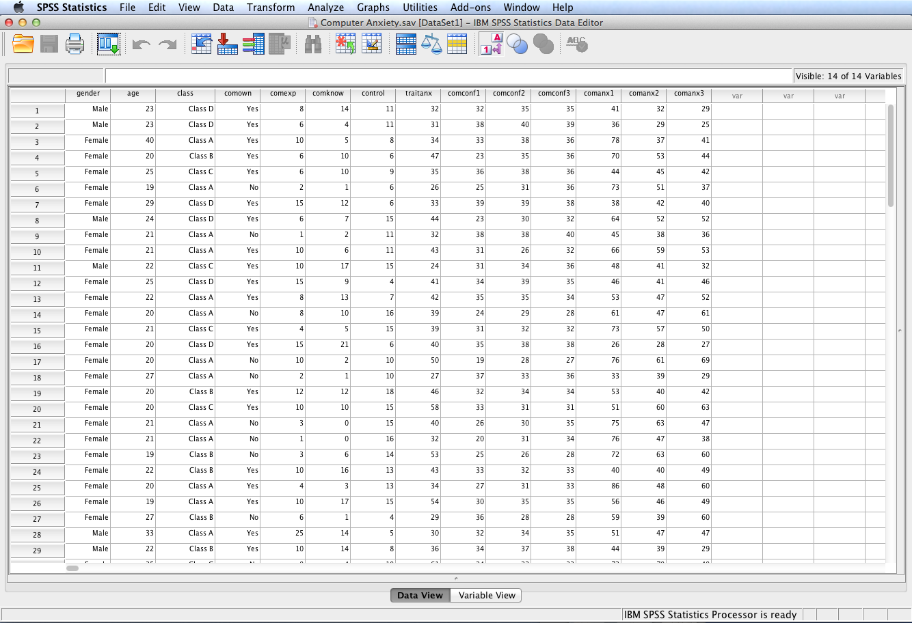
Open the dataset Computer Anxiety.sav.
File available at http://www.watertreepress.com/stats

Slide 5
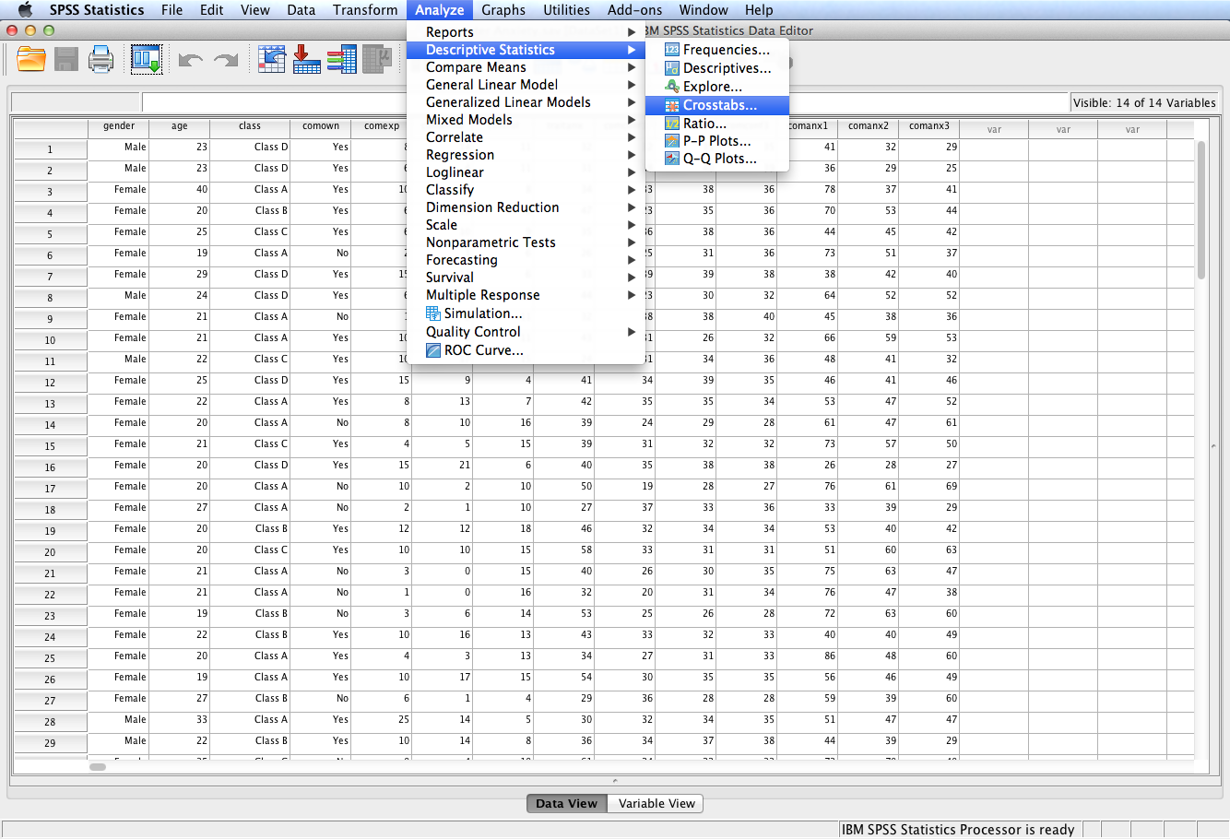
Follow the menu as indicated.

Slide 6
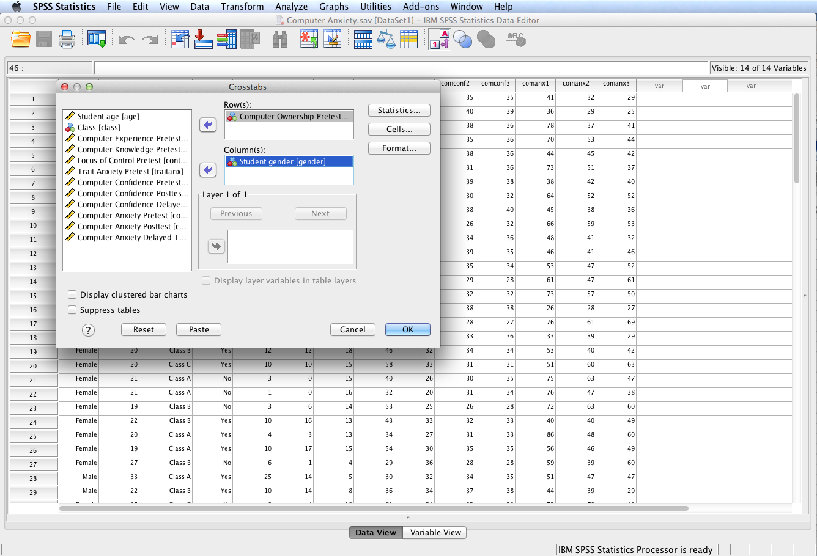
In this example, we will test the following null hypothesis:
H₀: The proportions associated with computer ownership are the same for male and female university students.
Select and move the Computer Ownership Pretest variable to the Row(s): box and Student gender to the Column(s): box.
Click Statistics…

Slide 7
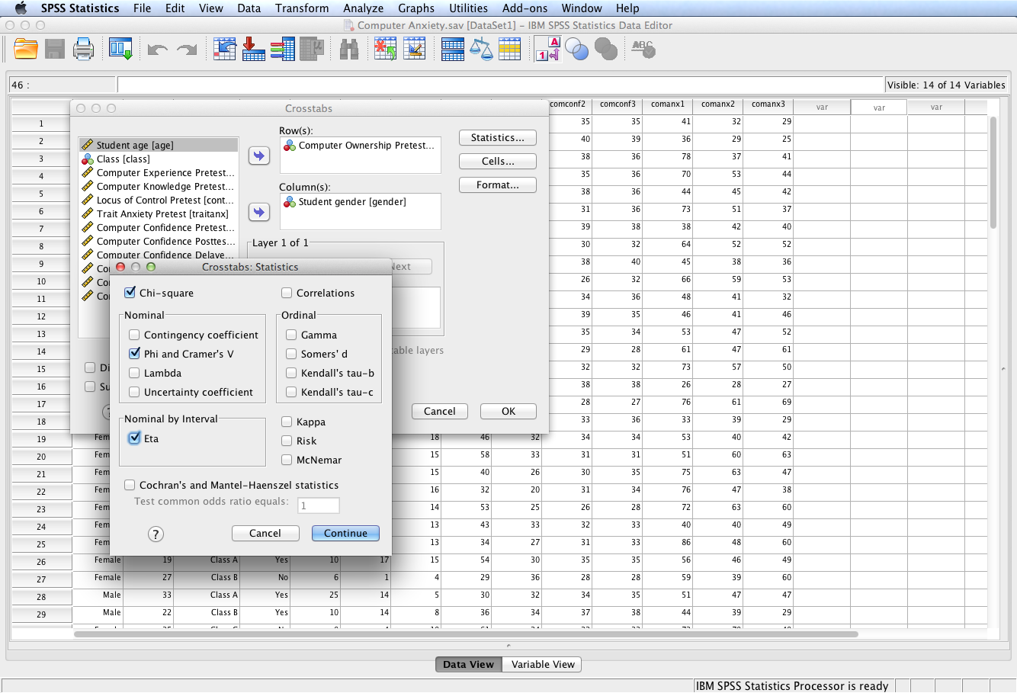
Check the Chi-square box and the Phi and Cramer’s V box; click Continue then OK.
Phi and Cramér’s V are effect size measures for contingency table analysis. If the Pearson chi-square test is significant, effect size should also be reported.
Also check the Correlations box for tables in which both rows and columns contain ordinal data. This displays Spearman's correlation coefficient, rho.

Slide 8
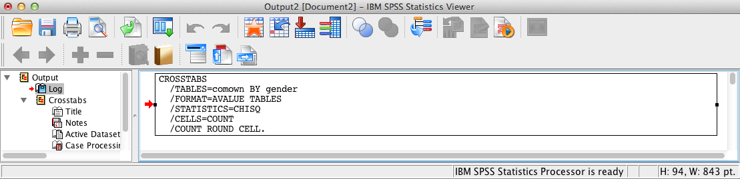
SPSS Output
The contents of the SPSS Log is the first output entry. The Log reflects the syntax used by SPSS to generate the Crosstabs output.

Slide 9
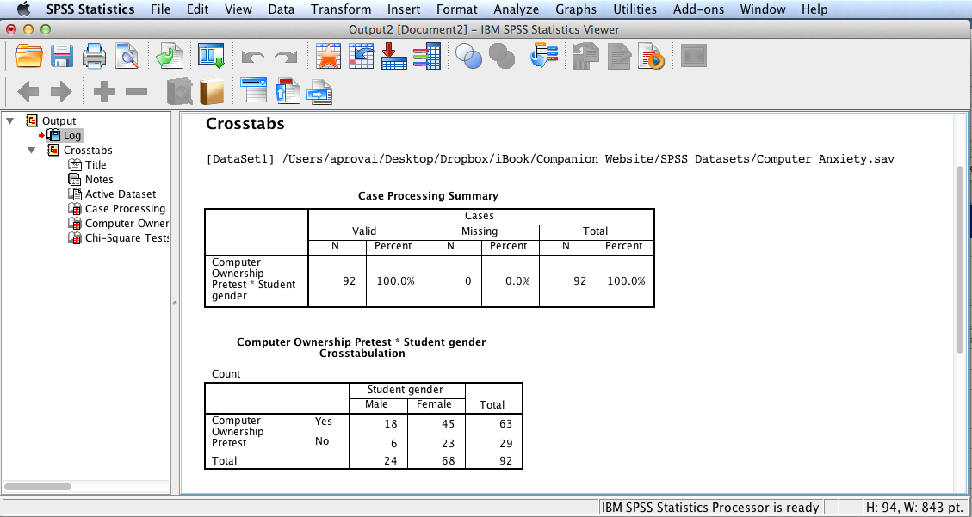
SPSS Output
Output also includes the case processing summary and the computer ownership pretest * student gender crosstabulation (i.e., contingency table).

Slide 10
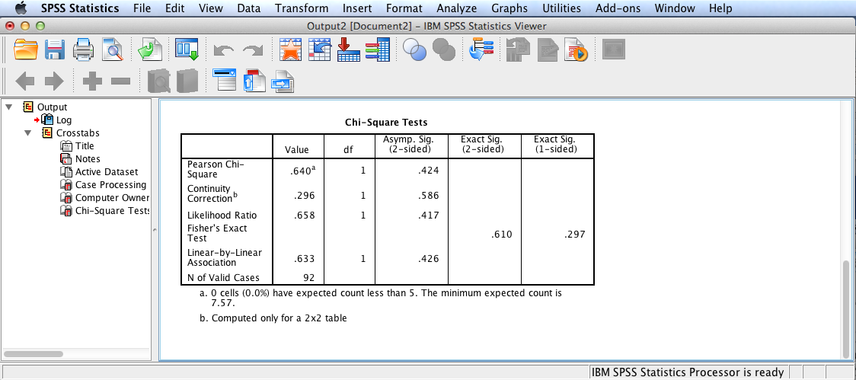
SPSS Output
The next tabular output provides the results of the chi-square tests. The first test listed is the Pearson chi-square test that tests the hypothesis that the row and column variables in a crosstabulation are independent of one another.
The above SPSS output shows that the Pearson chi-square test is not significant since the 2-sided significance level > .05 (the assumed à priori significance level). Continuity correction is provided for 2 x 2 tables. The continuity correction gives a better approximation to the theoretical sampling distribution for chi-square when the observed frequencies in any cell are small (less than 5), which is not the case here. Likelihood ratio tests the hypothesis using a log-linear model and is an alternative procedure for testing the hypothesis. Fisher’s exact test is used when one or more of the cells have an expected frequency of five or less. Linear-by-linear association is only appropriate when data are ordinal categories.

Slide 11
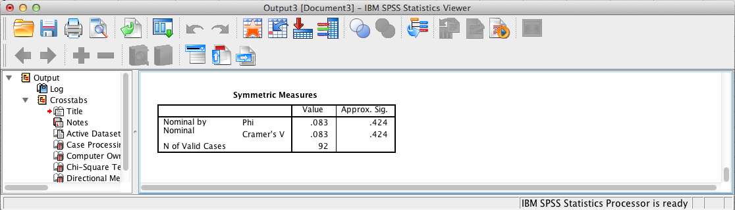
SPSS Output
Final output displays the results of the Phi and Cramér’s V tests: effect size procedures for Pearson chi-square contingency table analysis. Since the Pearson chi-square test is not significant, these results are not relevant.
Both Phi and Cramer’s V are measures of nominal by nominal association based on the chi-square statistic. Phi is used for 2 x 2 contingency tables and is the equivalent of Pearson r for dichotomous variables. When phi is used in larger tables, it may be greater than 1.0, making it difficult to interpret. However, Cramér’s V is used for larger tables and corrects for table size. For 2 x 2 tables, as is the case here, Cramér’s V equals phi.

Slide 12
Pearson Chi-Square Contingency Table Results Summary
H₀: The proportions associated with computer ownership are the same for male and female university students. The Pearson χ² contingency table analysis was not significant, χ²(1, N = 92) = .64, p = .42. Consequently there is insufficient evidence to reject the null hypothesis.
These results provide evidence that computer ownership is independent of student gender.

Slide 13
End of Presentation

